Slide 1

Clem, Timothy; Thomson, Patrick, "Static Analysis at GitHub". Communication of the ACM, 2022, vol.65, no.2
Mostafa Abdelmegeed
CSC640 – Software Engineering
10-31-2023

Slide 2
Content
Introduction
Motivation
Philosophy
Methodology
Code Navigation
Architecture
Performance Metrics
Conclusion

Slide 3
Introduction
Hundreds of Millions of Repositories
65 Million Developers
Symbolic Code Navigation (Click on Identifier, jump to definition)

Slide 4

Motivation
Navigating code is a fundamental part of reading, writing, and understanding programs.
Quick & Quality answers to programmer's queries.
Programmer's mental model of the program.
Effective modifications and troubleshooting.

Slide 5
Philosophy
Zero Configuration
Incrementality
Language Agnosticism
Progressive Fidelity
Human Partnership
Notes:
Incrementality. For each change pushed to a repository, the back-end processing should have to do work only on the files that changed.
Language agnosticism. The same back-end processing code should be run and operated regardless of the language under analysis.
Progressive fidelity. Results that are good enough should never wait for ones that are perfect
Human partnering. Great software tools augment and complement human abilities.

Slide 6
Methodologies
Notes:
Incrementality. For each change pushed to a repository, the back-end processing should have to do work only on the files that changed.
Language agnosticism. The same back-end processing code should be run and operated regardless of the language under analysis.
Progressive fidelity. Results that are good enough should never wait for ones that are perfect
Human partnering. Great software tools augment and complement human abilities.

Slide 7

Tree-sitter

Slide 8
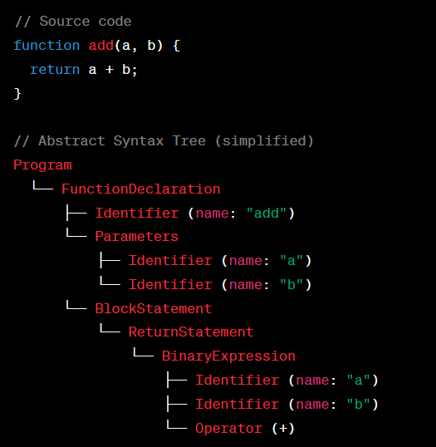
Tree-sitter example
Notes:
Concrete Syntax Tree
Tree-sitter's role in efficient parsing and navigation.
Benefits of generalized LR (GLR) parsing for handling various programming languages.

Slide 9
Architecture
Tagger
Indexer
Query Service
Notes:
Integration of open-source tools, data streams, and orchestration with Kubernetes.

Slide 10

Indexing
Handling large number of code pushes
Multiple languages support
Realtime availability

Slide 11
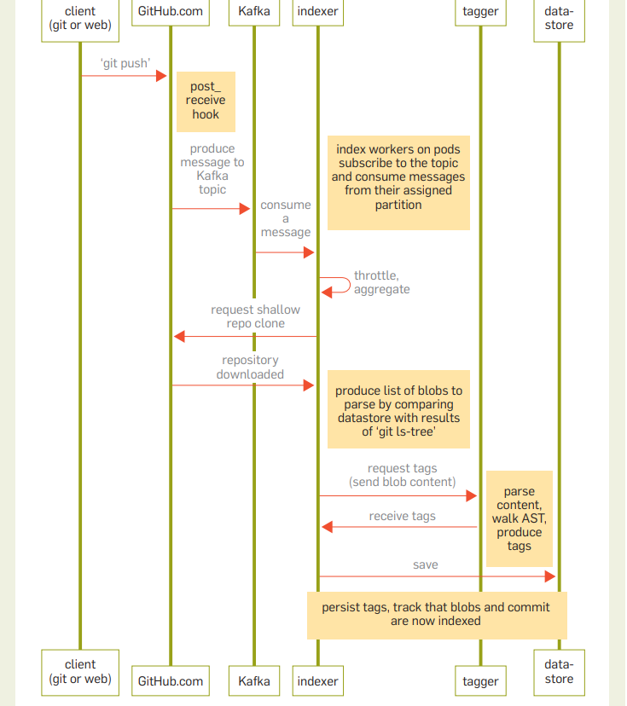
Indexer Sequence

Slide 12

Additional Advancements
Migration to Vitess for database scalability
Database migration (MySQL -> Azure Blob Storage)
Shifting from Semantic-based tagging to Tree-sitter queries.

Slide 13

Performance Metrics

Slide 14
Highlights
Push Processing: ~1000/min
Identifier Generation: ~2m/min
Indexing Speed: ~60s at 99th percentile, 50th is ~1.1s
Incremental Indexing: ~10s at 99th, ~1.3s at 50th
Symbol Lookup: 30,000 requests/min with p99 of ~90ms

Slide 15

Critique
Aggregation Throttling and Backpressure
Advanced Article
Justifications were OK but approach relied on first working solution

Slide 16

Questions?

Slide 17
Thank you!

Slide 18
Citations
Communications of the ACMVolume 65Issue 2February 2022pp 44–51https://doi.org/10.1145/3486594
GitHub

